Slide 1
ZOOM CLOUD RECORDING LINKS
Topic: CS2040C Wednesday Lectures
Start Time : Aug 11, 2021 09:40 AM
Meeting Recording:
https://nus-sg.zoom.us/rec/share/oYfemK_FB6PVwoyTA51egVb797s_F_AjyqRRFyXkHSU8D9uwGJQO-Il7HlJZVj4F.hv_jtM-EP3_6Rglb
Access Passcode: .eg2U5*z
-------------------------------------------------------------------------------------------------------------------------------------------------------
Topic: CS2040C Thursday Lectures
Start Time : Aug 12, 2021 04:24 PM
Meeting Recording:
https://nus-sg.zoom.us/rec/share/An8ftuaWg9LwuxtZLwpf_PLvqP0KXAuZla6ESr0Zhm4EaDJERapjVVSK358anCMW.neIUWqhPluXJ_WpD
Access Passcode: ?gt^0BA2

Slide 2
CS2040C S1 AY21/22
Welcome
Zoom etiquette:
Login using NUS account
No waiting room, so please do not share the meeting link publicly to keep the participants mostly from this class only
Mute yourself
Use display name = your name as in matric card,
Use profile picture = any non-blank profile picture…,
You are allowed to turn off your video if you prefer it that way (there is an optional we-fie session at the end)
Raise hand when you want to ask, I will occasionally see the participants window
Do NOT annotate on screen UNLESS the slides are designed for e-annotation and I instructed you to do so
Use private chat if you want to talk to others in this class during this class (very distracting to me otherwise), only use chat to me/public if you are invited to talk and want to give something that is better done via text, e.g., an URL

Slide 3
Agenda for the First Lecture
Introduction
About me
About (71* of) you
Course (online :O) tools + live demos
VisuAlgo (type https://visualgo.net or… Google search “algo visualization” :O)
Steven’s private “LumiNUS” (doubles as course admin talk, intro of 4 TAs)
Kattis (https://nus.kattis.com) online judge (https://open.kattis.com is optional)
(with C++ introduction, review some problems from Easy Coding Challenge + more)
Setting Expectations for this 100% e-Learning + Flipped Course
CP4 sales announcement (all via NUS co-op)

Slide 4
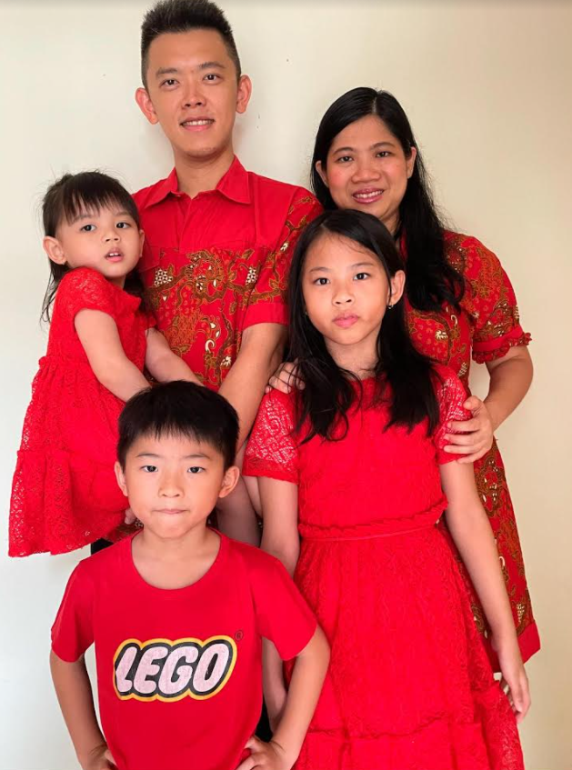
Lecturer: Dr STEVEN Halim
Read my IOI stuff (IOI 2021 and IOI 2020) or my ICPC stuff (ICPC Jakarta Online 2020) or my achievements (this news, NDA18, ATEA, or this list)
Office: COM2-03-37
(usually in every Mon-Fri, 10am-5pm; unless forced to do WFH)
Office Phone: [not really used, just email me]
Email: stevenhalim@gmail.com (‘the lecturer’ at Discord)
On Facebook, Instagram, Telegram (steven_halim_7)
Has 1 wife (Grace) and 3 ‘J’ kids (Jane, Joshua, Jemimah)
Wish for CS2040C S1 AY21/22:
To enjoy teaching without those heavy IOI commitments anymore
Notes:
Extras this, this, this, this

Slide 5
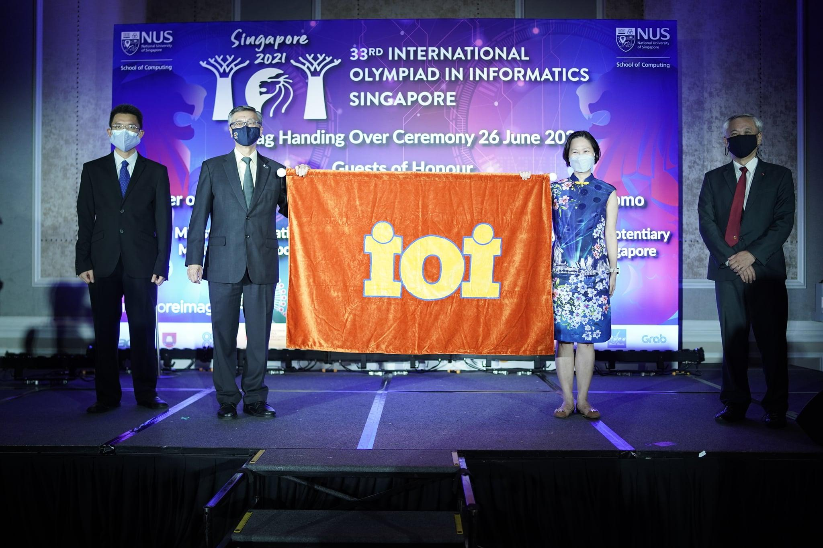

Slide 6
71* of you… (as of 10 Aug 2021, 11am SGT)
 | CEG Y1/2 | InfoSec | Exchange | Poly PP | Minor/2nd Major
Jul 2021 (Steven’s) Estimation | ~40 | ~20 | 0 | 0 | ~50
Reality (as of 10 Aug 2021) | “Only” 19 :O | “Only” 10 :O | 7?? (I thought this should be 0 again?, let’s analyze) | 0 (this column will be removed next time) | 35 29 FoE 3 FoS 1 FASS 1 BIZ 1 SDE
PS:
* if nobody drops / no new addition
Female students: ~14 (some of you don’t have LumiNUS photo), so about ~20% of 71 pax

Slide 7
71* of you (continued)
You should have background in at least one programming language
By passing/exempted from CS1010/its variants
This is true for CEG/InfoSec (the main audience)
Mixed background for (Local?) Exchange students (~7 students in this category)
But historically, ~[30..40]% students (your seniors) S-ed CS1010/its variants :O
So I assume most of you know at least one of C, Python, Java, or others
Most programming languages have “similar structure”
Convert yourself to C++17 coder along the way; it is just a “vehicle” to learn DS+Algo
(No longer) surprising (because I have said so in my welcome emails :O)
I prefer not to teach too much basic C++ in my version of CS2040C
You will mostly self-learn, GIYF, see discussion in Discord and the demos today
We will help A LOT along the way
Real life experience: My kids learning (real) language(s)
Notes:
Those coming from CS1010/E know C, (but CS1010E switches to Python from S1 AY2019/20)
Those coming from CS1010S know Python
Very few already know Java before

Slide 8
71* of you (programming language survey) Annotate/give a tick inside a region if you have coded using that programming language before
C S1 AY2021/22, about 20 ticks here | C++ S1 AY2021/22, about 20 ticks here | Python S1 AY2021/22, again most (40?) ticks are here
Java S1 AY2021/22, only about 10-15 ticks here | JavaScript S1 AY2021/22, only about 10-15 ticks here | Others (Elaborate) Rust, PHP, Scratch, etc Not important ☺, see the recordings for other programming languages that your classmates know

Slide 9
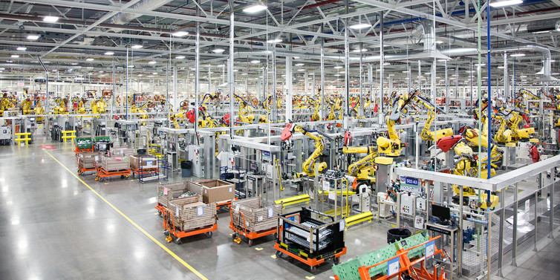
Age of Machines

Slide 10
VisuAlgo (https://visualgo.net --- or ask Google “algo visualization”)
Built (since 2011) and controlled by myself (but currently on development freeze)
My dream is to have a virtual copy of myself available 24/7
Very patient in explaining basic concepts; Never complains; Always available
Your lecture notes (the e-Lecture mode, demo)
zh/id languages are somewhat ready for 8 CS2040C modules so far ☺
Print-friendly (trial mode): Open console, type “openPrinterFriendly()” :O
Your personal instructor/tutor (the exploration mode, demo)
Your examiner (the 10% Online Quiz, demo; actual setup this sem TBC)
Register an account (DO NOT USE; to be fixed by new FYP 2021/22)
The current user account system is BROKEN (some registration email never arrives, etc)
Notes:
login for tracking (no need for 2019++ until I fix that sytem)

Slide 11
Flipped Classroom Strategies (for medium to large class)
The style will continue to be enforced, i.e., no basic discussion of ‘trivial stuffs’ if VisuAlgo e-Lecture slides are already clear enough for majority of students
Consequently, those who do not read the prescribed e-Lecture slides before lecture will be really lost during the real lecture…
For today, those who didn’t do Week 00 “Easy coding challenges” @ Kattis will struggle :O…
Steven will just use his experience to discuss the usually top-X hardest slides/topics to be re-explained live (but online), in e-class, plus “AMA session”
71 is a “small”/medium-sized class, so there are moments where I will use Poll Everywhere tool (http://www.cit.nus.edu.sg/poll-everywhere/), but not today
We will then able to use remaining lecture time to solve some (easier) Kattis problems that require understanding of the ongoing topic that week

Slide 12
Online Classroom Strategies (Special for S1 AY21/22)
Recurring Zoom meetings on Wed 10am-12noon and Thu 5-6pm (the flipped e-Lecture discussed earlier :O) – links given in official welcome email (don’t share the links publicly to minimize “weird appearances of unknown people”)
Lecture recordings will be uploaded sometime on Friday noon
Recurring Zoom meetings on Mon/Tue for Lab+Tut combined 2h sessions
Each Lab+Tut will be handled by one TA
2 Monday sessions will be cancelled and 2 session will likely be made into F2F sessions (TBC)
Recurring Zoom meetings on Fri/Sat for floating 2h consultation slots
Manned by designated TAs (paid :O!!), they will be there at said timeslot
Can be joined by ANY student that needs help at those time
So basically, help is just one Zoom meeting away every single day EXCEPT Weekend
Important: Steven purposely will NOT reply emails after 8pm every day and between Saturday 12noon - Sunday 8pm (“Sabbath”)
Ask at Discord group, there should be others who are “free-er”, mention @staff

Slide 13
C++ IDE (or lack thereof)
Our C++ default standard is C++17 now (until C++20 becomes ‘common’)
Preview of “test_cpp_17.cpp” to test compiler setup
My setup is simply a text editor and a compiler
Editor: Sublime Text 3 (I bought a License ☺), Compiler: g++
For e-lectures, I use this instant stuff: https://repl.it/languages/cpp
But be careful that everything here is public and only good for quick testing
If you do your PSes online like this, your code can become the source of plagiarism by others who Googled :O…
For PE preparation (Week 11)
Normal semester: I suggest that you learn to use DevC++ Visual Studio though
This still COVID-19 affected semester: If we can do onsite PE, then VS
VS are installed in the labs (used in S2 AY2020/21) and it can be set to do C++17
Notes:
For Sublime setup, if you want, myself, tutorial, or lab TA can help you on this setup thing
But you can stick to your own setup if you don’t prefer this way
CS2040C:
Cygwin64 or MinGW, install g++
CS2040C:
Yet another alternative: CodeBlocks (but this software is notoriously buggy)

Slide 14
For Practical Exam (PE) on Week 11 (TBC)
For PE on Week 11 (Details TBC, lots of admin to sort out),
If fully online: You actually can use any C++17 compliant compiler that works on your own computer/laptop
If hybrid (mostly onsite – onsite proctored, the rest online – e-proctored): Use Visual Studio in our PLs (which can be setup to do C++17)
You have 11 weeks from now to familiarize yourself with C++ related tools in your own computer/laptop
The e-Proctoring details will be confirmed later
Either way, it will be “Open Internet” :O…
See “Open Internet programming exam” presentation that I shared with NUS colleagues last year (BEFORE THE PANDEMIC) : https://www.comp.nus.edu.sg/~stevenha/myteaching.html
Notes:
You will have to use a PC (laptop) in our PLs for actual PE (controlled environment), PL2+PL4 labs have used new Acer Nitro laptops from last year’s ICPC Asia Singapore 2018

Slide 15
Steven’s CS2040C Private LumiNUS (https://www.comp.nus.edu.sg/~stevenha/cs2040c.html)
Let’s do a tour:
Overview of the module, LOs, TAs, syllabus, and course registration info
Latest news will be prominent upon loading that page
Very detailed lesson plan, detailing each week, with integrated ‘Files’ and clear weightage indicator for each weekly milestones
Bookmark important dates on your calendar!
Class roster with mini gamification component
But since there are many of you, only student with at least one achievement will appear in that partial class roster list
PS: Discussion forum are at Discord (primary); Facebook Group abandoned)
Join (https://discord.gg/G3x4yNfDeT) if you haven’t, be FOMO* for this…
Primary mode now: Discord (can be anonymous)
For FB: Create a dummy FB account that contains nothing if you actually don’t like FB
Notes:
FOMO = Fear of Missing Out

Slide 16
Kattis Online Judge (OJ), NUS version :O (https://nus.kattis.com)
Online judges for (much) more programming exercises
Steven will mention relevant, CS2040C level problems from these OJs
Our PSes and PE will use nus.kattis too
Let’s do a live demo of solving a few simple problems with C++
Easy C++ coding live review 1 (involving ‘array’++): lostlineup
Live SPEED coding, wish me luck!!, then I will re-explain
Reference: CP4 – Book 1, page 23-30
Notes:
Last few AYs
Kattis hello, really just to test the O part of I/O
Kattis judgingmoose, simple if else
Kattis timeloop, simple I and N times O, curly braces styles, indentation styles
Kattis mia, can be used to demonstrate the usage of function to simplify/modularise code, if-else
Kattis treasurehunt, chosen to showcase recursive function (can be written iteratively), also about 2d array and recursive function :O, and first time showing the usage of … global variable :O
Kattis statistics, highlighting either a simple array or on-the-fly computation with built in library
Kattis compass, Remarks about indentation, preference of as local variable as possible vs global variables :O, variable naming, etc

Slide 17
Week 00 Tasks for S1 AY21/22 – in one slide CP4 – Book 1, page 23-30
Already discussed in our CS2040C Discord channel, #easy-coding-challenge
/greetings2 is about "I/O + Sequences Only"
/tarifa is about "Repetition Only", "trivial loop"
/moscowdream, "Selection Only", "if-else check; be careful with ‘that’ corner case"
/numberfun, "Multiple Test Cases + Selection", "be careful of division by zero"
/fizzbuzz, "Control Flow", "a simple interview problem"
/sifferprodukt, "Function", "you can use (user-defined) function the process is repeated here:
Discussed on Wed/Thu
/lostlineup, "1D Array Manipulation, Easier", "introducing std::vector"
/brokenswords, "Easy", "std::string input example, simple counting"
For your own challenge
/bossbattle – not that hard actually
/interpreter – the most tedious in this set
I can't access students' past grade (of relevant module) anymore due to PDPA, so this is an early indicator whether your CS1010/variant grade is good or not
Notes:
For CS2040C only -> Remarks about #include <bits/stdc++.h>, https://www.quora.com/Is-it-good-practice-to-use-include-bits-stdc++-h-in-programming-contests-instead-of-listing-a-lot-of-includes

Slide 18
We are nearing the end for today
Let’s take a class we-fie for the third fully online + flipped class of Steven’s CS2040C
I really dislike online classes and hoping to return to some normalcy soon…
Unfortunately 71 pax is >> 50 pax so we still can’t…
Hopefully things get better in the future
SGP can see some light at the end of the tunnel…
But we need to wait for many other parts of the world to be safe before we all can be safe
PS: By turning on your camera (and being randomly chosen in the gallery view), you give consent for the we-fie photo to be shared publicly in Steven’s social media
I just need about ~25 of you (first Zoom gallery view page) to do this

Slide 19
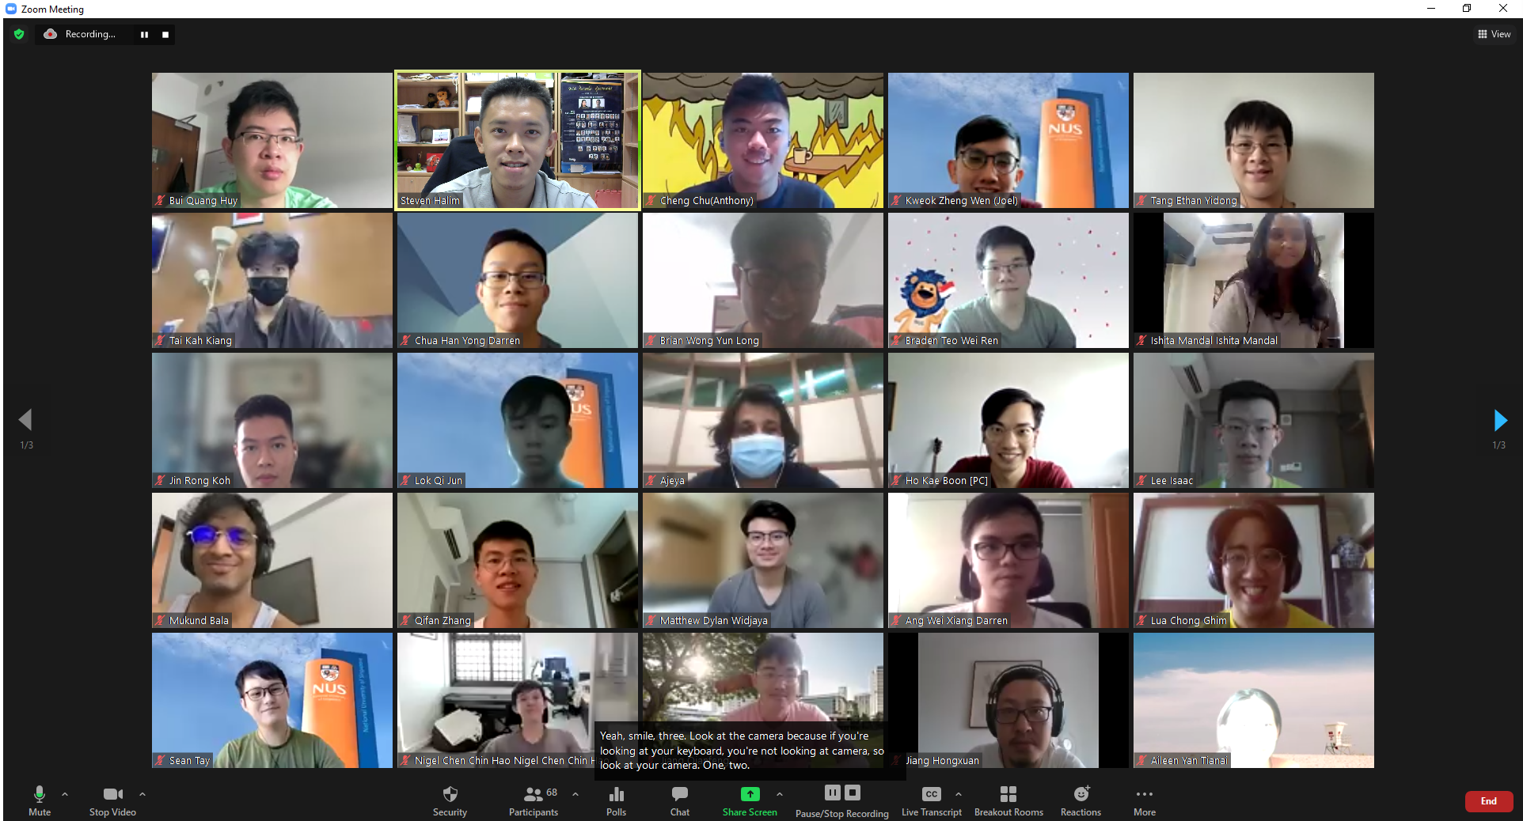
Our Momento

Slide 20
End of Wed, 11 August 2021 e-Lecture
These admin slides and all relevant C++/Py/Java demo code will be uploaded to (real) LumiNUS “Files” after Lecture 01b
PS: CP4 Book 1 sales customized for CS2040/C/S of S1 AY 20/21 is exclusively done via NUS co-op this time
https://www.nuscoop.sg/search?keywords=competitive%20programming
Order Book 1 (24.60 SGD) online or go to NUS co-op central forum directly
It is 32.00 SGD :O (after GST) at Popular bookstores (while stocks last)
It is 19.99 USD (excluding the expensive shipping cost) if bought from lulu.com
The older editions: CP3/variants (from seniors/friends) are still useful though
CP1/2 are now “free”, see https://cpbook.net/details?cp=2

Slide 21
Demos, continued The actual C++/Py/Java lesson topics are written as comments in C++/Py/Java code; All source code will be zipped together and sent to you later
C++ Live Demo, continued (this time using Visual Studio) :
Easy C++ coding live review 2 (now involving String): brokenswords
Reference: CP4 – Book 1, page 31-32
Then a quick discussion of ofugsnuid (a problem with automated partial marks)
First, we start with the first 3 of its 4 subtasks
Let’s purposely write “weaker” solutions to aim for lower points…
Most of our PSes and PE tasks will have ‘partial marks’ like this
Then discuss heimavinna
About string parsing/tokenization using stringstream
It also has subtask systems
It will be re-coded using C++ ‘class’ at the start of next Wednesday lecture
Although that is super overkill (but a necessary introduction before we discuss harder data structures)…
Notes:
Similar problem from last AYs: bookingaroom, princesspeach, quickbrownfox, freefood
Kattis quickbrownfox / princesspeach / bookingaroom / freefood, a practice using a C++/Py/Java class, we actually can solve this problem without even using a class, but I have to teach you C++/Py/Java class :O, so…

Slide 22
Setting Expectations
You canNOT S/U this level 2 module (it has pre-requisites :O)
Aim for the best possible grade that you can get
CS1231 is NOT set as pre-req; relevant material will be pre-discussed
With ‘only’ 71* students, NUS standard Bell Curve system is partially*used
Read this public writeup of the 2012 version of NUS Bell Curve system written by the previous NUS provost, now current NUS president
Work hard to self learn as many programming language components
As I said, we will help along the way, throughout this module
CS2040/C/S will NOT use very deep Java/C++/Java concepts
For CS students, you will learn deeper Java stuffs in CS2030/S
CS2040/C/S assignments will be short (< 50 SLOC), unlike CS2030/CS2103++

Slide 23

Help with Flipped Classroom
This learning technique is likely very new for many of you
It takes lots of self-discipline to make it work
Pre-read the e-Lecture slides @ VisuAlgo before coming to live lecture
You will be very lost otherwise…, I will be very strict on this :O
I record all Zoom sessions and upload the recording at LumiNUS multimedia usually on Friday morning every week
Ask lecturer or TAs for help, especially during early days
At Discord, you can mention @staff to alert any of the staffs
Our consultation hours are shown in Steven’s private LumiNUS
Only contact @the lecturer for last resort (or policy issues), there are general discussion forum (Discord/FB group) and TA consultation hours

Slide 24
Prelude to the First Real Flipped Classroom
By next Wednesday, 18 Aug 2021, you must have read https://visualgo.net/en/sorting?slide=1 until slide 9-3 at least
Last year (2020), Steven has finally got time to digitize the important parts of the CS1020/E Analysis of Algorithms lecture notes at https://visualgo.net/en/sorting?slide=6 until slide 6-11, please read them first
You will be super duper lost otherwise…
See you again soon…
Online :O

